Slide 1



DRAFT
Automation Platinum Demo
Leveraging deployed ODM decision services in watsonx Orchestrate
Introduction and overview

Slide 2
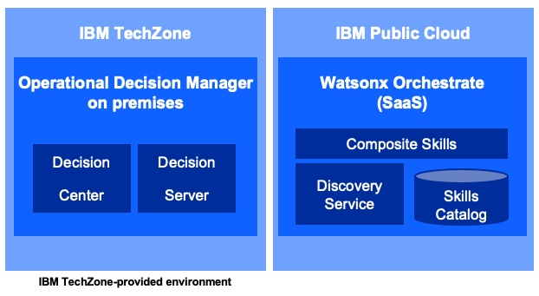
Demo overview
REMOVE THIS SLIDE BEFORE PRESENTING TO CUSTOMERS
Purpose of this deck | This deck is to be shown to customers to introduce and summarize the Leveraging deployed ODM decision services in watsonx Orchestrate Platinum demo.
Scenario overview | The demo uses a hiring process example to illustrate how and existing ODM customer can reuse and expose deployed ODM decision services as watsonx Orchestrate skills to further improve employee's productivity
Product(s) in the demo | Watsonx Orchestrate – IBM Operational Decision Manager on prem (deployed on IBM Cloud)
Capabilities to be demonstrated | Watsonx Orchestrate – Discovery Service – Decision Center – Decision Server
Supported product version(s) | Watsonx Orchestrate SaaS (release Nov 2023) – ODM 8.11 ODM 8.12 (On prem and SaaS)
IBM Technology Zone page | TBD
Demo Components
DRAFT

Slide 3
Demo overview
DRAFT
Scenario
The customer service wants to improve agents' productivity when dealing with customers calling in to return a product. The agents must go through different applications and make decisions to register such a claim.
The customer service wants to reuse the exact same ‘return validation’ service implemented in ODM and used by the Focus Corp enterprise applications . An expert creates a new skill from the deployed ODM service to make the exact same decisions from watsonx Orchestrate.
To further improve business productivity, a composite skill is created to prevent agents from entering numerous customer and ‘returned items’ fields required to invoke the decision skill. A skill recovering the data from the Focus Corp database is coupled to the new ODM skill.
Each call center agent can now add this new skill in their personal skill set. In just one sentence, on one click, they are able to know in real time, if a purchase can be returned and under which conditions.
IBM Digital Labor Capabilities
watsonx Orchestrate
IBM Operational Decision Manager

Slide 4
Demo flow
DRAFT
Introduction
Show the deployed decision service
Create a new skill
Focus Corp wants to improve their call center productivity by reusing existing ‘return decision’ services
An existing decision service managing ‘return decision’ is used by the enterprise applications
A new skill able to invoke this decision is created using a discovery service
Publish and use the skill
Create a composite skill
Use the composite skill to show how fast the decision is made from a very simple interaction
A skill flow sequencing a data recovery skill and the decision skill is created to improve agents' productivity.

Slide 5
Demo components
DRAFT
IBM TechZone or IBM Cloud
IBM Public Cloud
Operational Decision Manager
Watsonx Orchestrate (SaaS)
Composite Skills
Decision
Center
Decision
Server
Discovery Service
Skills
Catalog
IBM Public Cloud
IBM TechZone-provided environment or Shared IBM SaaS environements

Slide 6
DRAFT
DEMO
Leveraging deployed ODM decision services in watsonx Orchestrate

Slide 7
Key takeaways
Leveraging deployed ODM decision services in watsonx Orchestrate
DRAFT
Built-in Discovery Service …
Built in wizards to connect to IBM Automation products (ODM and RPA)
Provides connectors to CP4BA on SaaS and CP4BA on premises
Eliminates the complexity to create skills from existing IBM Automation applications
Composite skills bring more value by combining skills with each other in a linear flow to perform more elaborated tasks. Data mapping between 2 consecutive skills is performed automatically based on the output and input data structures.
Rule based automation provides a robust scalable and comprehensive rules management capabilities to author, test deploy, govern and manage complex business policies.
Conversation style skill use turns watsonx Orchestrate into an assistant you can chat with to perform time consuming tasks.
Notes:
auses

Slide 8
DRAFT

Slide 9
Additional learning resources
DRAFT
IBM watsonx Orchestrate
Learn more about the features highlighted in the demonstration:
Connecting to CP4BA - on premises
Combining skills into a skill flow
Enhancing and publishing skills
Working with the Decision Center
Managing rules in the Decision Server

